Slide 1

Sphinx
Keeps us safe

Slide 2

Gruppo FOS challenge
DATA
ESP32
Receiver
Low Consumption
Automatization
Multi-devices

Slide 3
Input Data: photos
Consumer-grade devices
ESP32
Client
Sleep
Automatization
Low consumption if no request
Automatic connection in range

Slide 4
SNEAK PEEK

Slide 5
Optimisations
Usage of BLE
Configuration via bluetooth
Callbacks
Reduces energy usage
Reduces energy usage if none is connected
Changes the photo rate
BLE optimisation C++

Slide 6
Thank you for your attention!

Slide 7
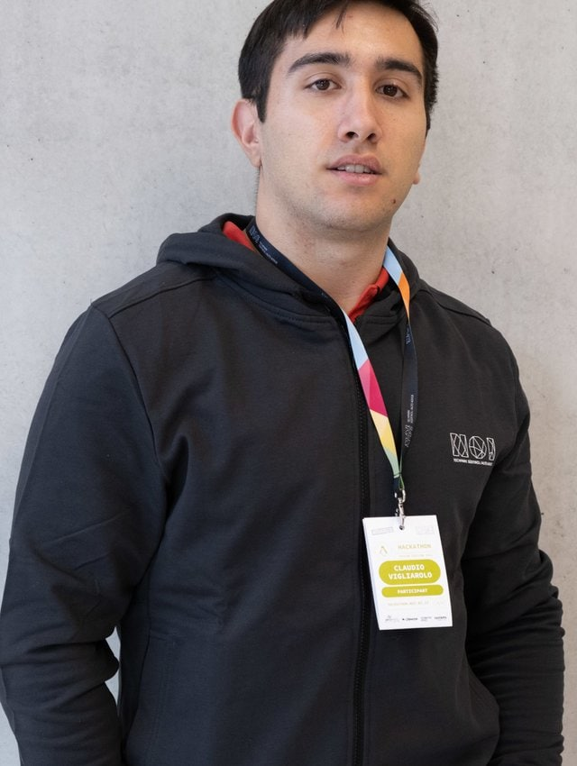
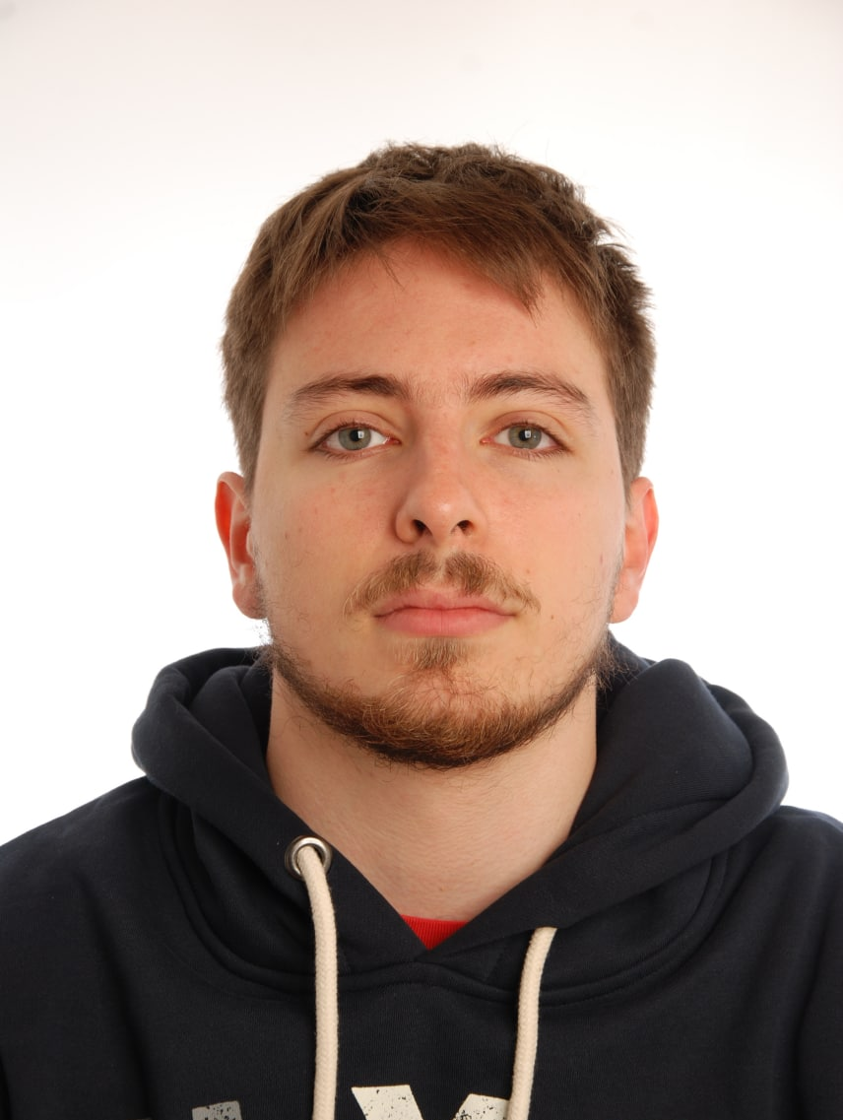
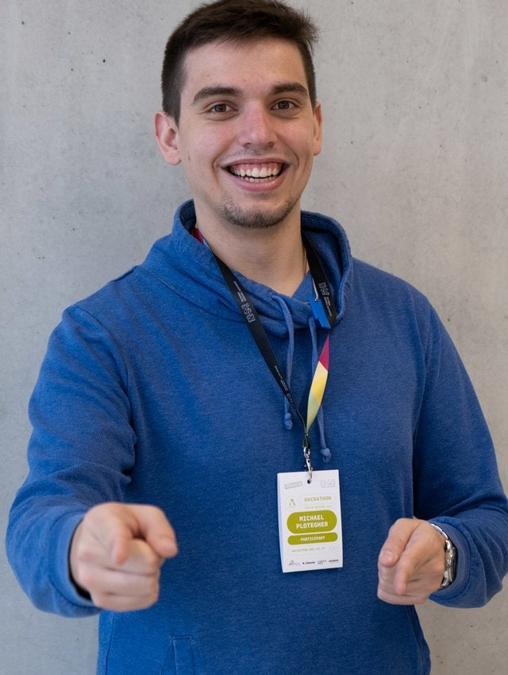
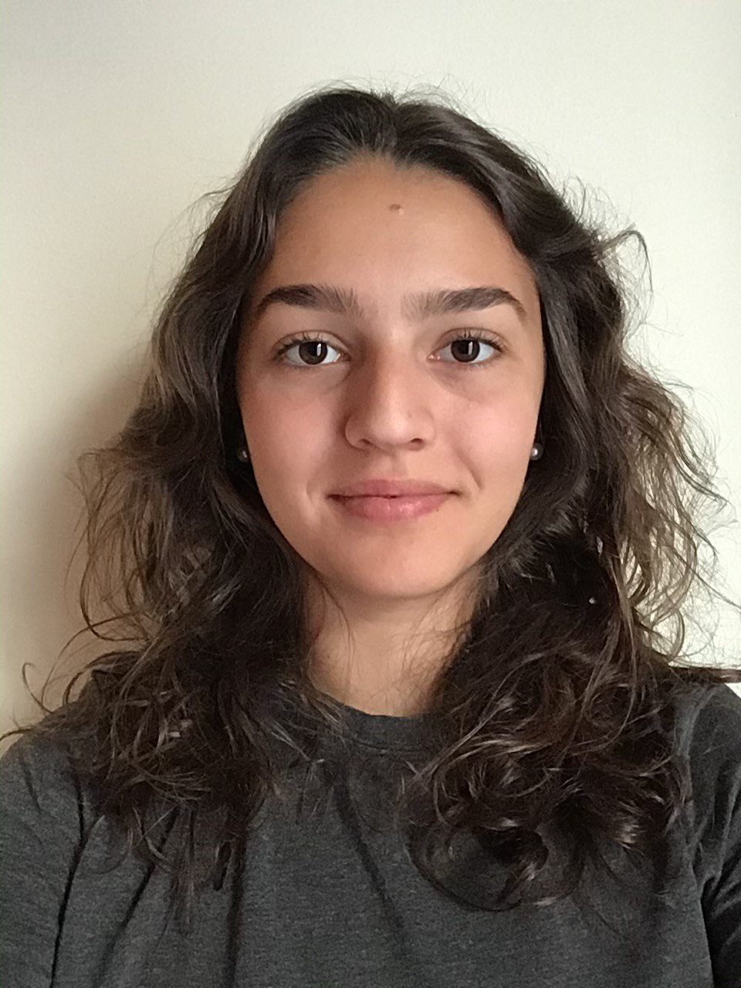
That’s us!
Claudio Vigliarolo
Eugenio Berretta
Michael Plotegher
Giulia Cramarossa

Slide 8
RESOURCES
<a href="https://www.flaticon.com/free-icons/bluetooth" title="bluetooth icons">Bluetooth icons created by Bombasticon Studio - Flaticon</a>
<a href="https://www.flaticon.com/free-icons/bluetooth" title="bluetooth icons">Bluetooth icons created by Freepik - Flaticon</a>
<a href="https://www.flaticon.com/free-icons/bluetooth" title="bluetooth icons">Bluetooth icons created by Smashicons - Flaticon</a>

Slide 9
RESOURCES
Did you like the resources on this template? Get them for free at our other websites.
PHOTOS
Woman using smartphone with hologram
Happy businesswoman looking at camera with holding pencil and diary
Portrait of smiling man holding digital tablet looking at camera
Smiling bearded man holding disposable coffee cup while opening door
Portrait of pretty woman holding laptop looking at camera
Motherboard with optical fiber
Futuristic technology screen interface
Front view of businessman holding high tech tablet
Businessman holding the newspaper and smiling
Multiracial group of cheerful coworkers
Happy young couple exchanging love messages
Smiling business people team sitting around the table in the meeting
VECTORS
Technology background with gradient colors
Blue 5g concept background
Abstract landing pages with technology devices
PREMIUM ICONS
Big Data Icon pack
PREMIUM PHOTOS
Short haired business woman laughing

Slide 10


